Slide 1
Decision Theory and Large Language Models

Slide 2
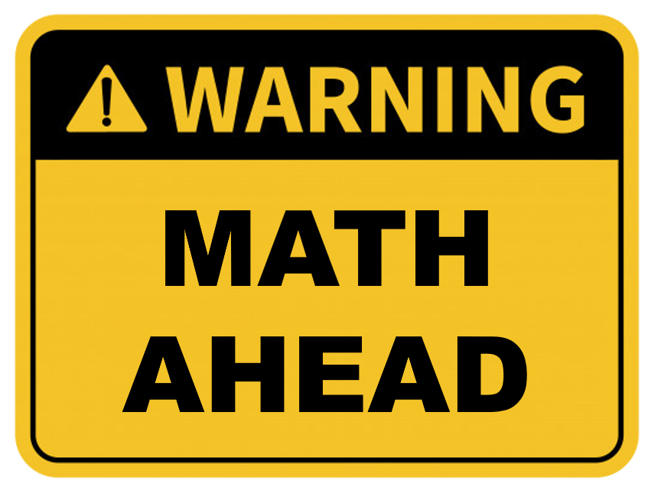
Before we go any further…

Slide 3
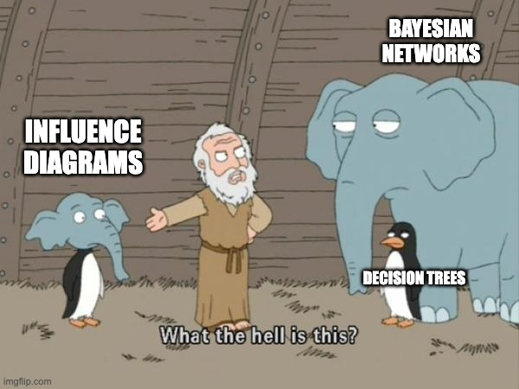
What the presentation was going to be about

Slide 4
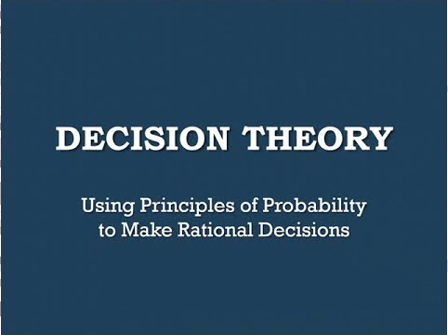
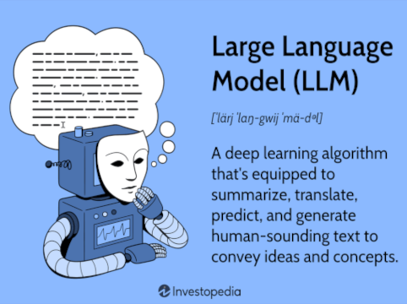
What the presentation is going be about

Slide 5

And if I pique your curiosity…

Slide 6
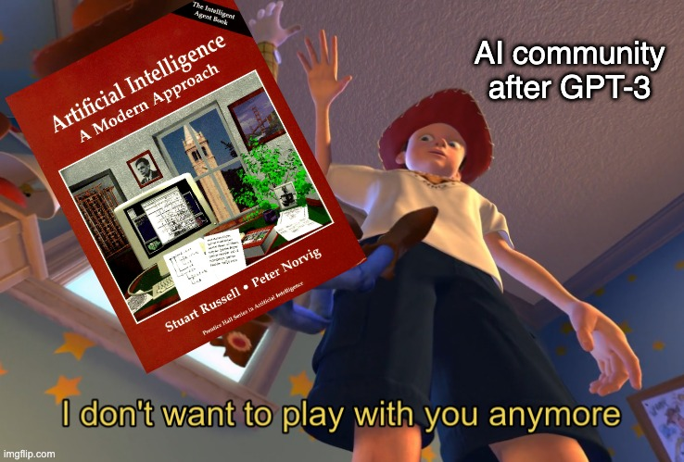
Why decision theory?

Slide 7
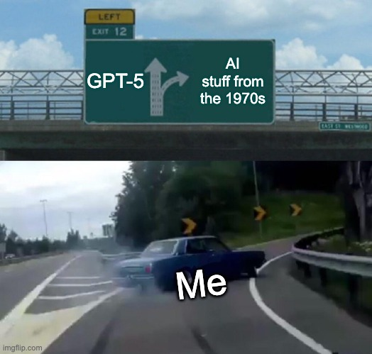
Why decision theory?

Slide 8
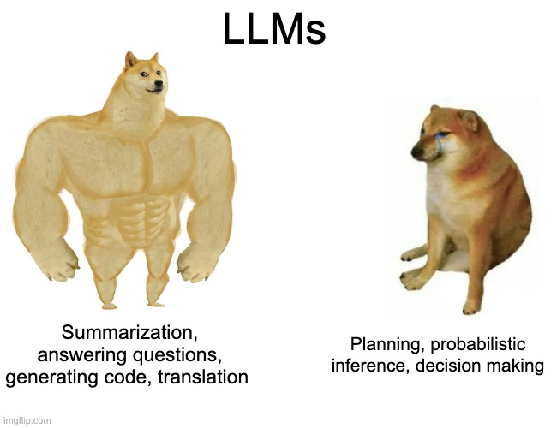
Why decision theory?

Slide 9
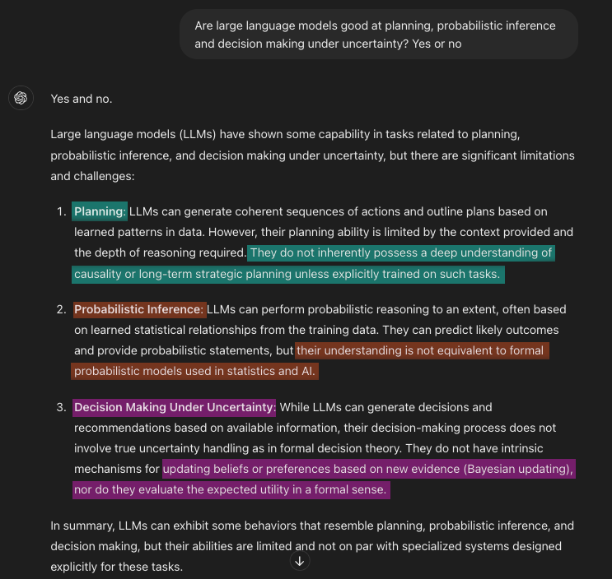
GPT-4o knows its place

Slide 10

A “simple” decision problem

Slide 11
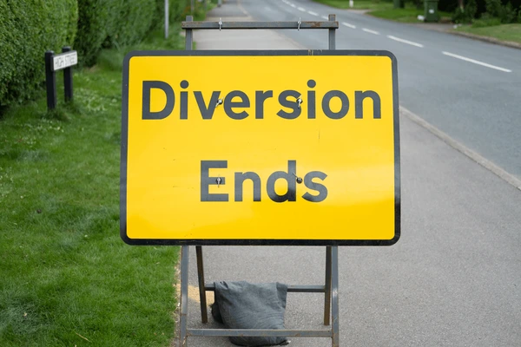
A “simple” decision problem

Slide 12
Thank you
Fernando Rodríguez
Vintage AI Enthusiast

